Slide 1




Luddy School of Informatics, Computing, and Engineering
Phase 2 - HOME CREDIT DEFAULT RISK - GROUP 11
Bindu Madhavi Dokala
(bdokala@iu.edu)
Jagadeesh Kovi
(jagakovi.iu.edu)
Sai Sathwik Reddy Varikoti
(svarikot@iu.edu)
Pranay Chowdary Namburi
(pnambur@iu.edu)
INDIANA UNIVERSITY BLOOMINGTON

Slide 2
Presentation overview
AGENDA
Project Description
EDA and Visual EDA Summary
Overview of Pipelines Implemented
Discussion and Results
Conclusion
Next Steps (4P’s)

Slide 3
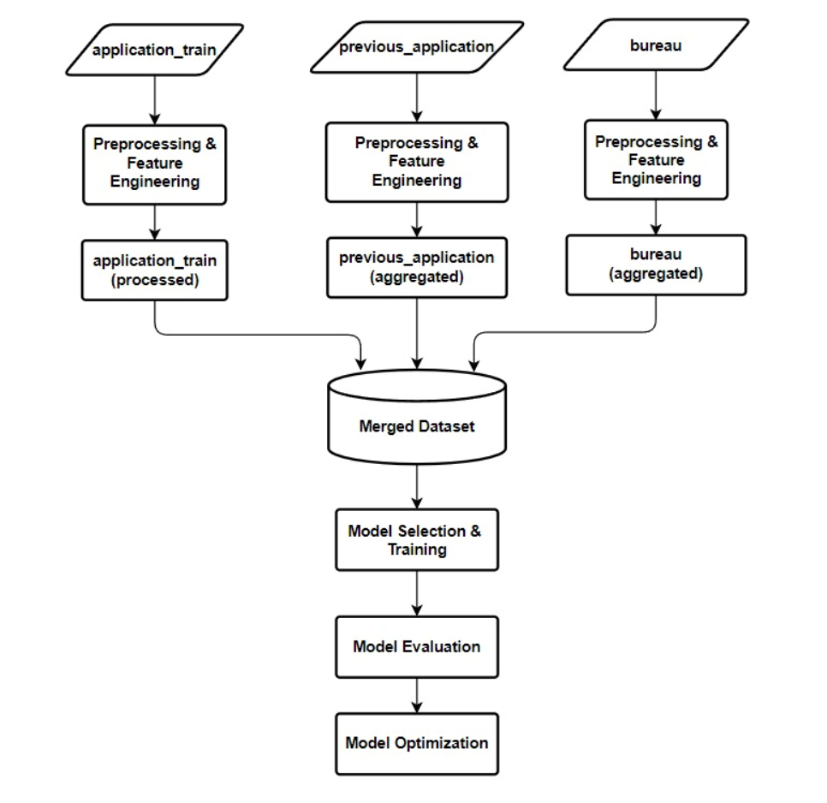
Project Description and Workflow
PROJECT DESCRIPTION AND WORKFLOW
For this phase of our project, we used data from the "Home Credit Risk Analysis" competition on Kaggle. Our goal was to explore the data in detail through Exploratory Data Analysis. We made several visualizations to see how different factors are related to the "Target" variable, which helped us identify the applicant with the highest default risk.
Performed feature engineering on the tables (bureau, application_train, and previous_application). In this process, we created new features by grouping data based on its primary key and applying the mean as an aggregate function on several crucial columns related to the domain. We used a column selector to consolidate all features for use in the pipeline. We applied feature engineering and hyper-parameter tuning on basic models such as Logistic Regression, Lasso Regression, SGD and compared their performances.
Workflow

Slide 4
Exploratory Data Analysis.
EXPLORATORY DATA ANALYSIS
We were able to describe the key characteristics of the data set using statistical graphics and other data visualization approaches with the help of exploratory data analysis.
The Data types and General Statistics of data.
Number of Missing values (percentage of the missing values.)
Numerical and Categorical Data.
We also visualized the missing data for each dataset
Correlation of the numerical data with the “Target column”.

Slide 5
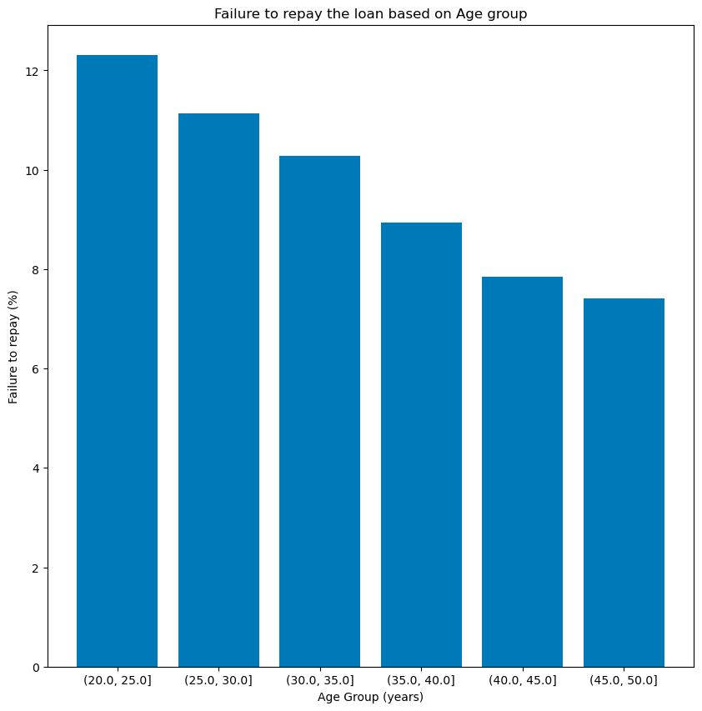
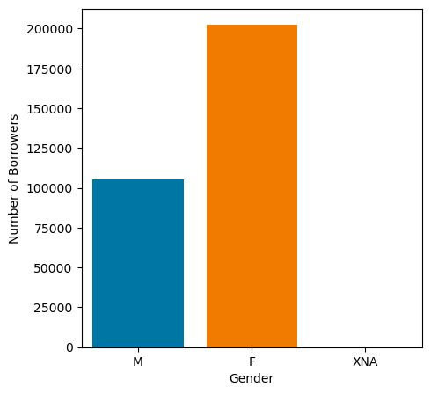
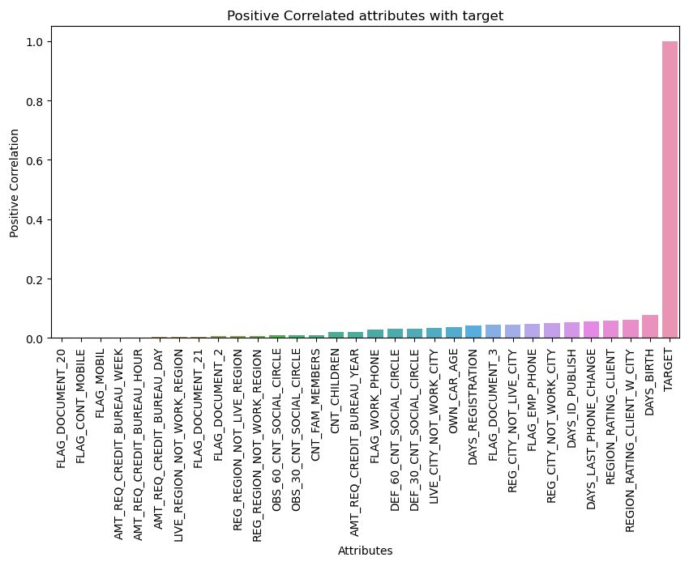
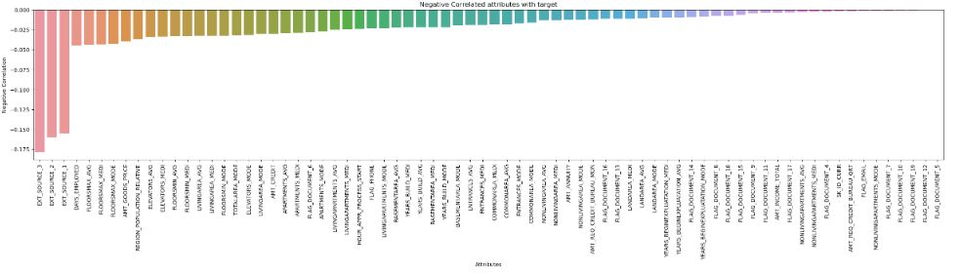
Visual Exploratory Data Analysis
VISUAL EXPLORATORY DATA ANALYSIS
Visual Exploratory data Analysis performed on Categorical values to understand their significance in data.
And analyzed relevant features with respect to target variable. Showing some visualizations on the right.
The graphs below depict the column features which are Positively correlated and Negatively correlated, based on target.
Age
Gender

Slide 6




Machine Learning
DATA CLEANING AND PREPROCESSING
Logistic Regression
Lasso Regression
Stochastic Gradient Descent Regression
Workflow for the project is discussed and distribution of responsibilities to work on HCDR project.
Three algorithms were selected for this project including baseline logistic regression, SGD regressor, Lasso regression with full batch dataset and also with undersampled dataset
Metrics used in the problem are F1 Score, Confusion matrix, Recall, Precision Score, AUC
Machine Learning pipelines outlined for our case

Slide 7
Discussion and Results
RESULTS
Model | Basis | Test Accuracy | Test AUC | F1 Score
Baseline Logistic Regression | Full Batch Gradient Descent | 91.94% | 74.36% | 0.0272
Logistic Regression | 15 Features | 91.59% | 73.55% | 0.0120
Logistic Regression | With Undersampling | 77.21% | 73.82% | 0.3192
Lasso Regression | With Undersampling | 75.60% | 70.89% | 0.0
SGD Lasso Regression | With Undersampling | 66.14% | 60.52% | 0.4166
Logistic Regression | With Undersampling | 77.92% | 60.86% | 0.3783

Slide 8
Conclusion
CONCLUSION
Our project was about using machine learning to predict if Home Credit customers default their loans. We tried out some baseline machine learning pipelines with logistic regression, lasso regression, and SGD, making them better with feature engineering, hyperparameter optimization, and using undersampling. We evaluated them using some key metrics. The best accuracy (91.94%) was achieved using baseline logistic regression with full batch gradient descent; however, its low F1 score (0.0272) suggests potential imbalanced class performance.
Going forward, we plan to test more algorithms such as SVM, KNN, GBM including XGBoost, and neural networks. We also want to improve by trying out different feature engineering techniques, and sampling methods, as well as incorporating domain-specific knowledge and expanding the dataset. Our work starts to help Home Credit make better choices about loans and help people who usually don't get enough financial services.

Slide 9
4 P’s
4P’s
Past | Present | Planned | Problems
Understanding and loading the Data | Implemented EDA and Visual EDA | More Feature Engineering and feature selection on other tables too. | Merging 8 huge datasets
Analyzing the baseline code | Feature Engineering for baseline pipelines | Hyperparameter Tuning and Ensemble methods | Implementing various models on huge dataset
Discussion of ML Algorithms and metrics | Performed aggregation of features and joined the tables | Implementation of Neural Networks | Training models taking lot of time
Design basic pipelines | Experimented with baseline pipeline models (Ex. Lasso, LogisticReg) and got the scores | Analysis of Loss functions And comparing the best performing models | Plotting graphs for huge datasets crashing kernel sometimes (Due to more RAM usage)

Slide 10
Thank you

